Slide 1

Comprehensive Analysis of Google Play Store Apps
Presented by
Siva Sai Prabhu Teja Kondapalli
Aparna Virupakshi
Pravallika Isukapalli
Madan Sai Daram
Ibrahim Uddin Mohammed
Guided by
Dr. Giri Narasimhan

Slide 2
Agenda
Overview & Background
Aim
Motivation
Dataset
Techniques
Exploratory Data Analysis
Models
Results & Discussions
Conclusion & Future Work

Slide 3
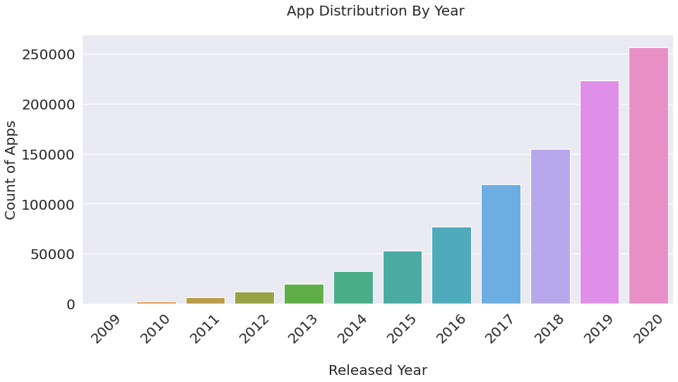
Overview & Background
App Importance
App growth over the years
Revenue

Slide 4
Aim
1
2
Interpret
3
Provide
Study
Factors

Slide 5
Motivation
Apps Popularity
Influence on Apps resemblance

Slide 6


Dataset
Google Play Store apps
10k Instances, 13 Attributes
Google Play Store User Reviews
64k Instances, 5 Attributes
Google Play store App Permissions
148k Instances, 24 Attributes

Slide 7
Techniques
Missing Values
Data type conversion
Classification

Slide 8
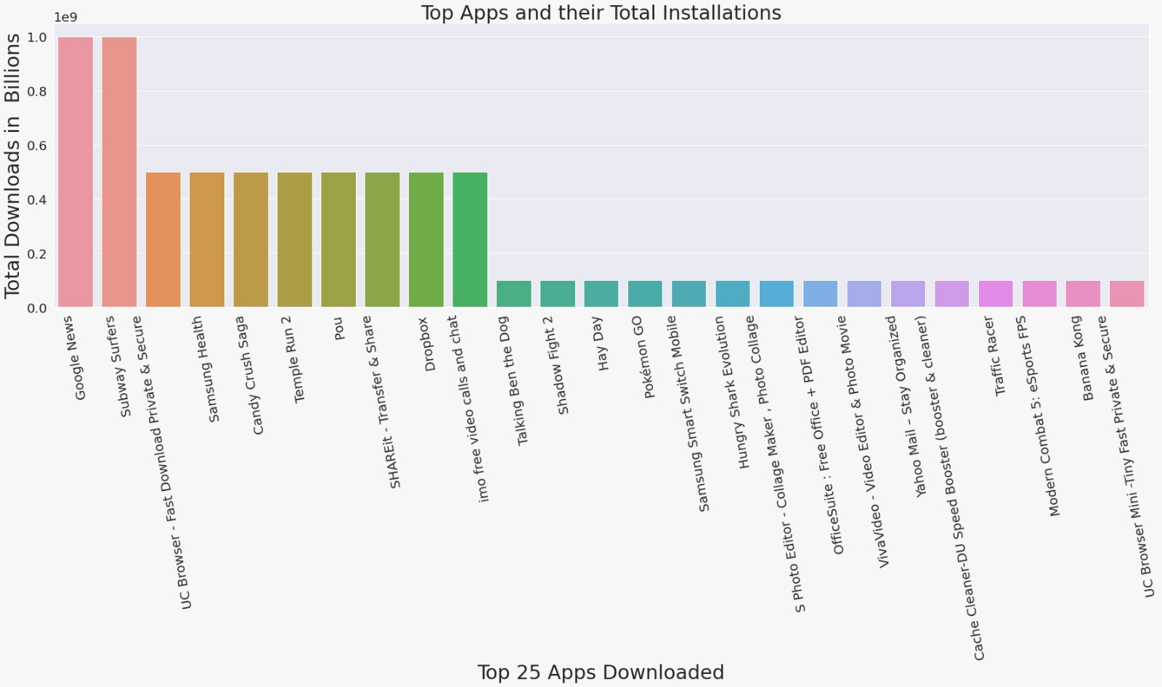
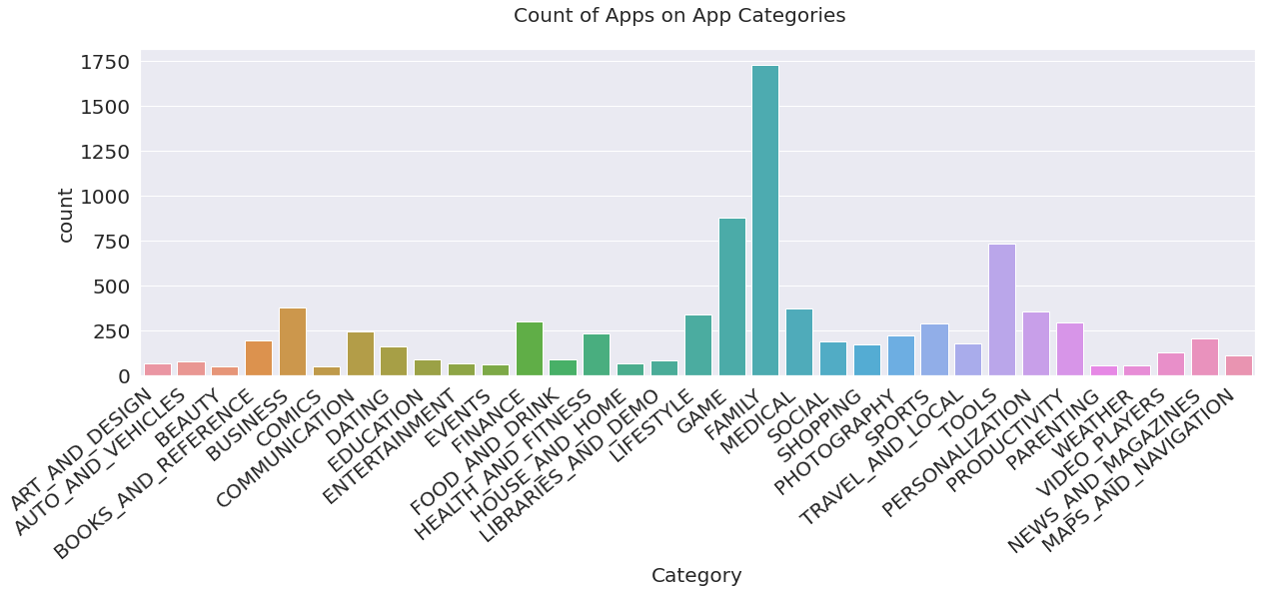
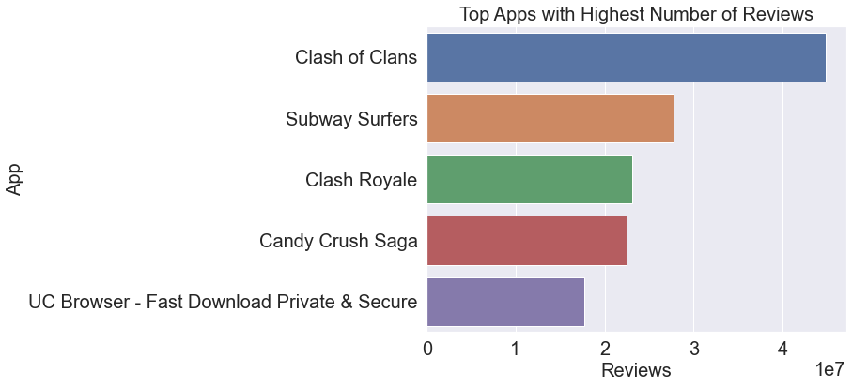
Exploratory Data Analysis
Top Reviews
High Count
Most Downloads
App

Slide 9
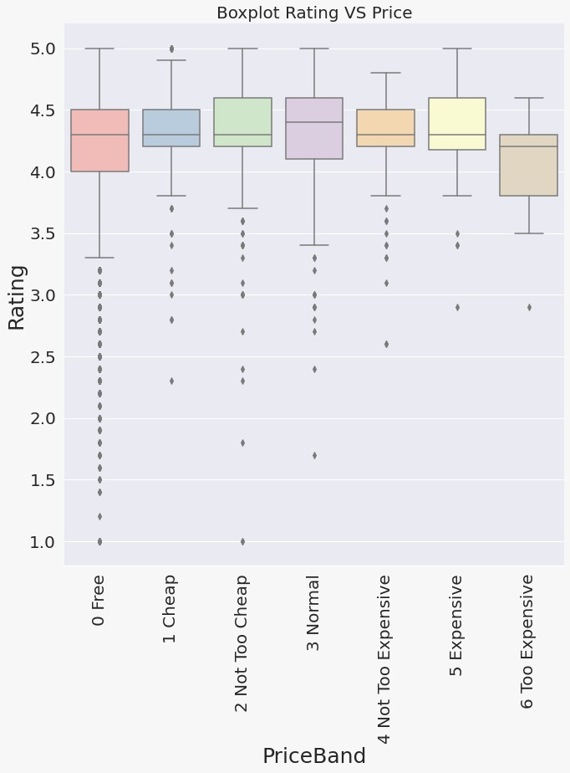
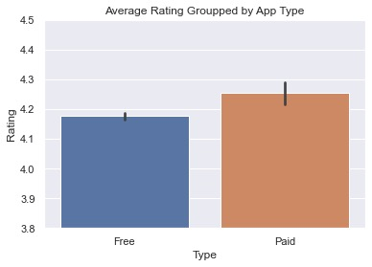
Which price band has a better rating?
Rating

Slide 10
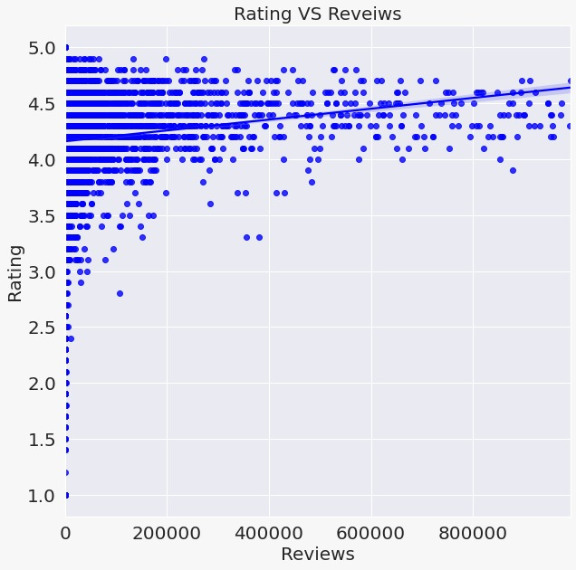
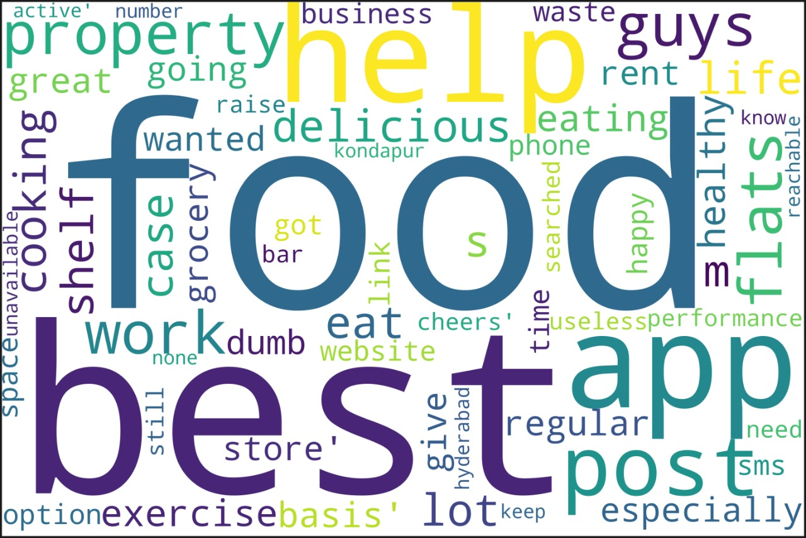
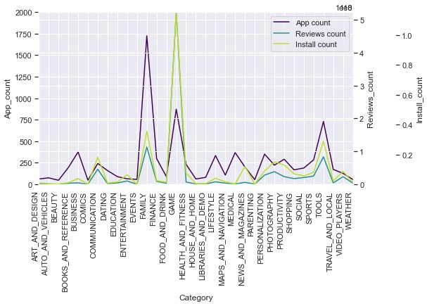
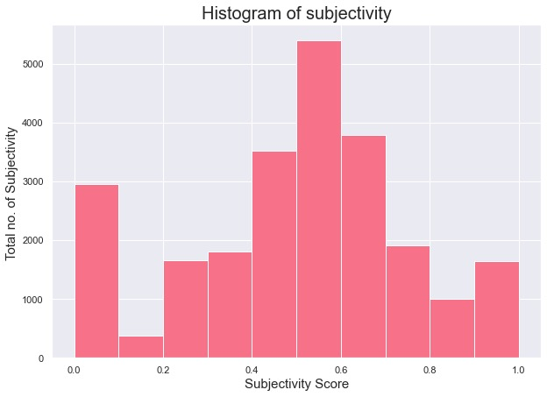
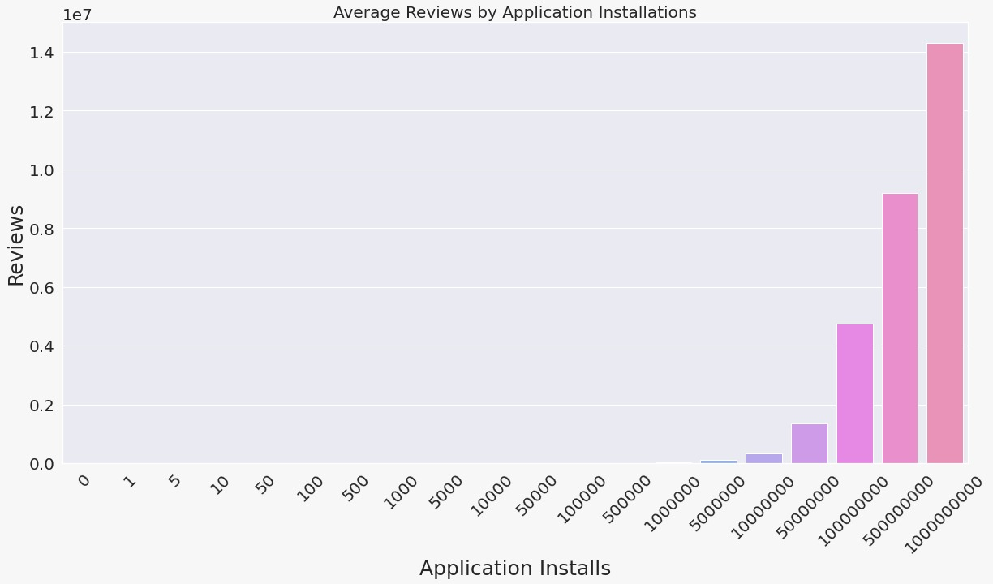
Do high reviews dictate anything?
Are reviews subjective?
At what brackets reviews are high?
Reviews

Slide 11
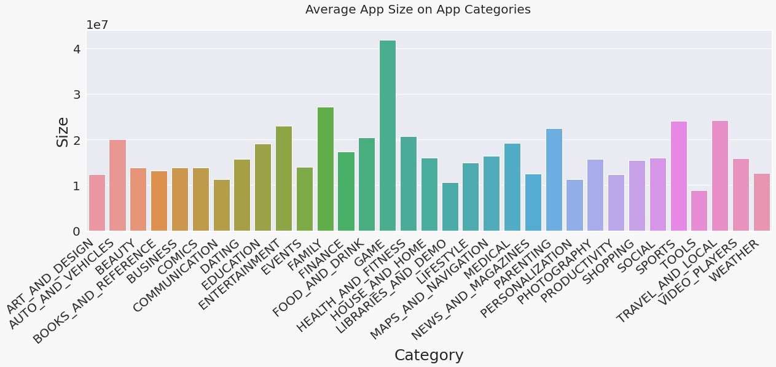
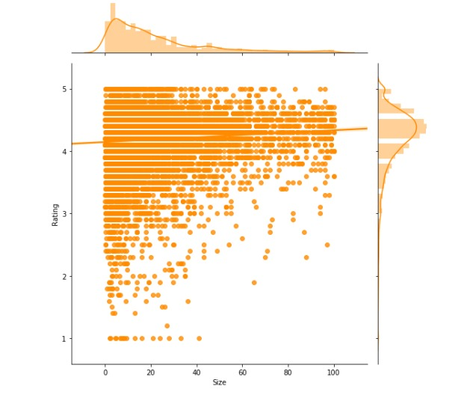
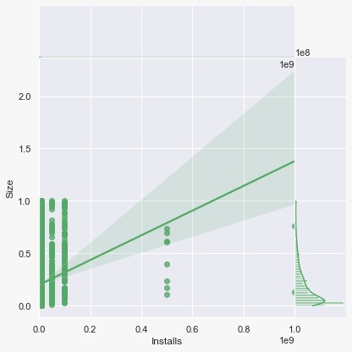
Optimal size range?
Size

Slide 12
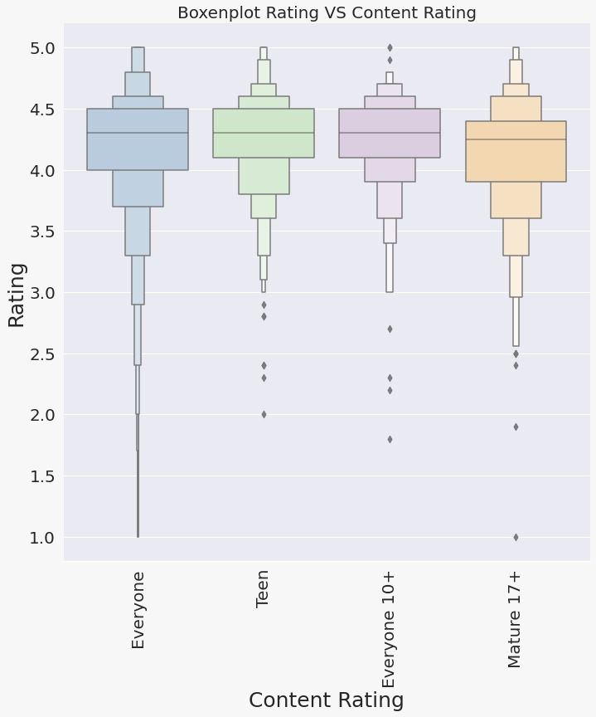
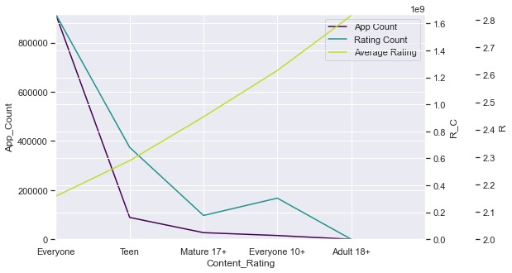
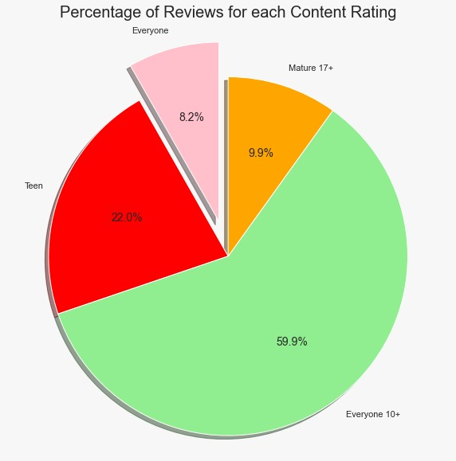
Best content rating out of five?
Content Rating

Slide 13
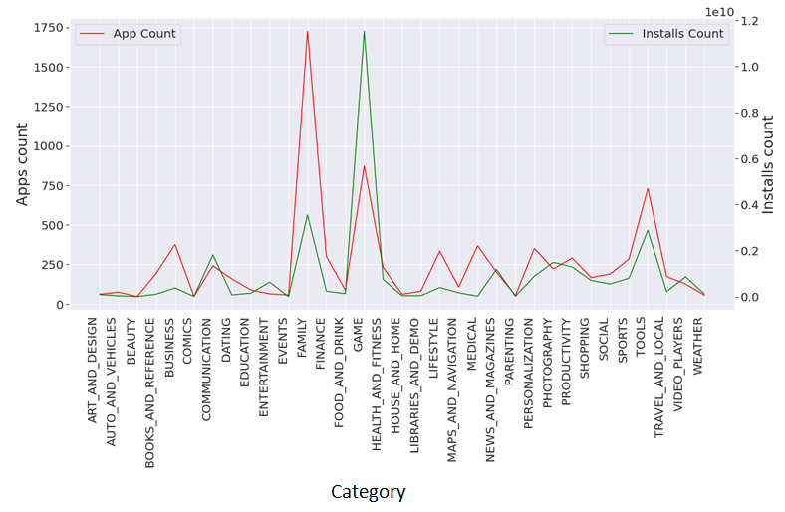
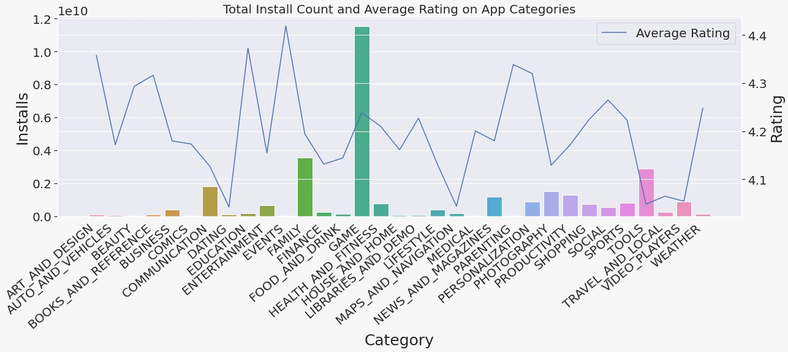
Do the below factors affect Installs?
Rating
App Count
Installs

Slide 14
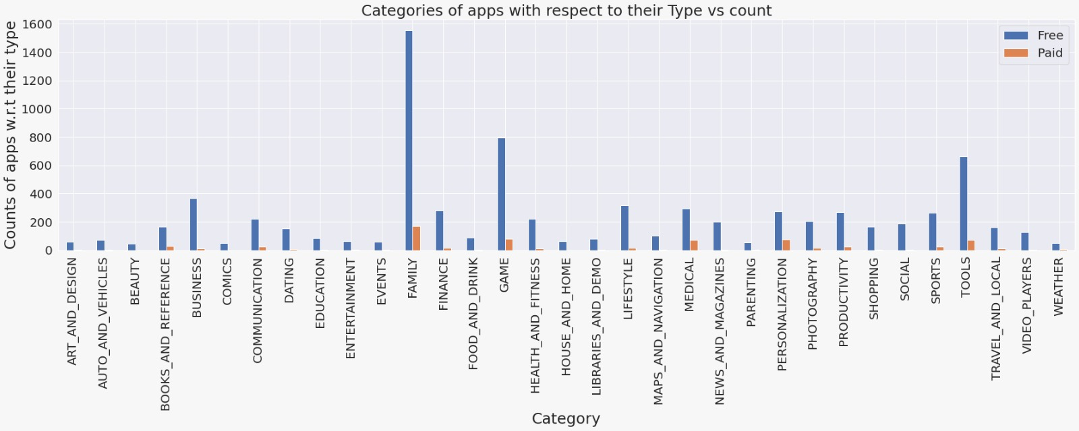
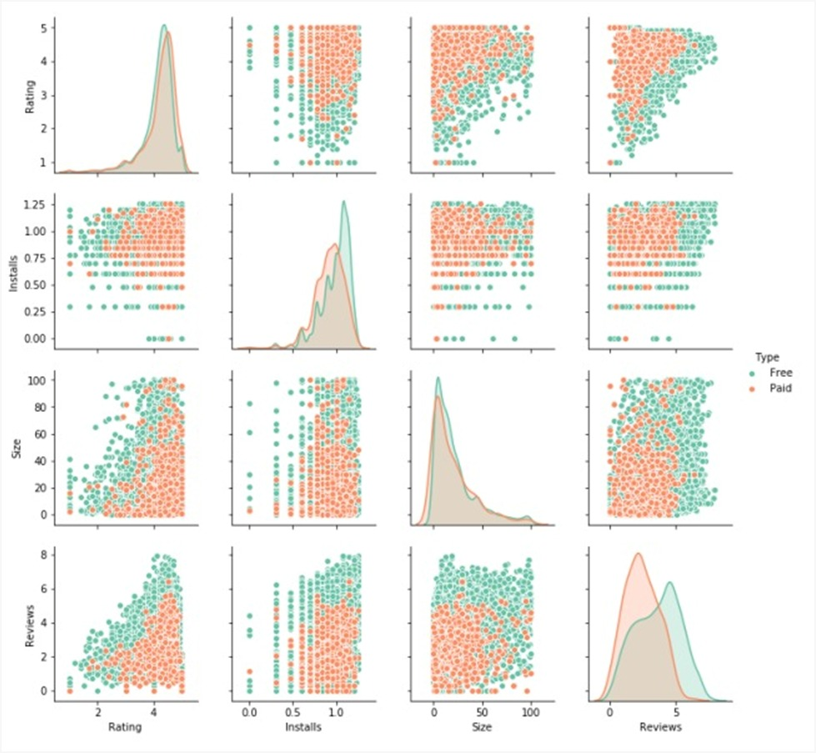
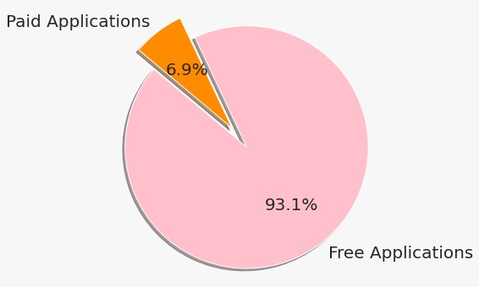
Which type has huge occupancy?
Paid or Free?
Type

Slide 15
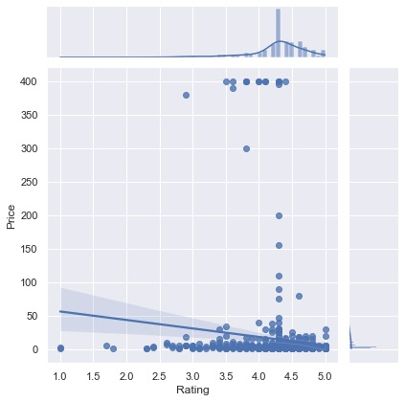
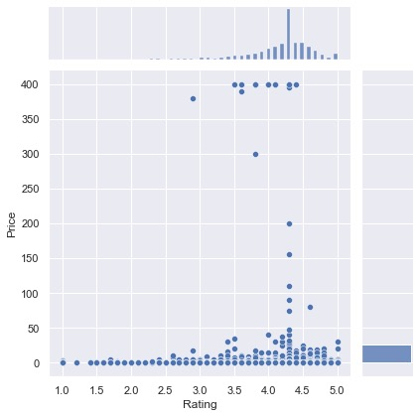
Best price bracket?
Price

Slide 16
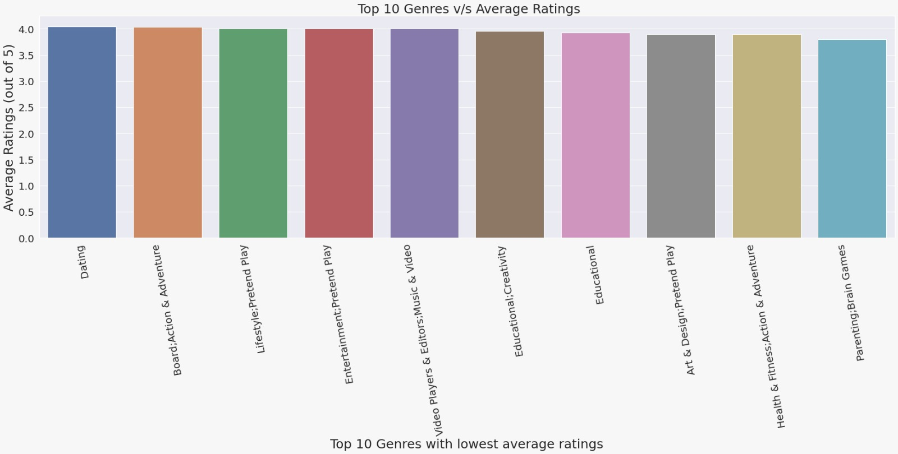
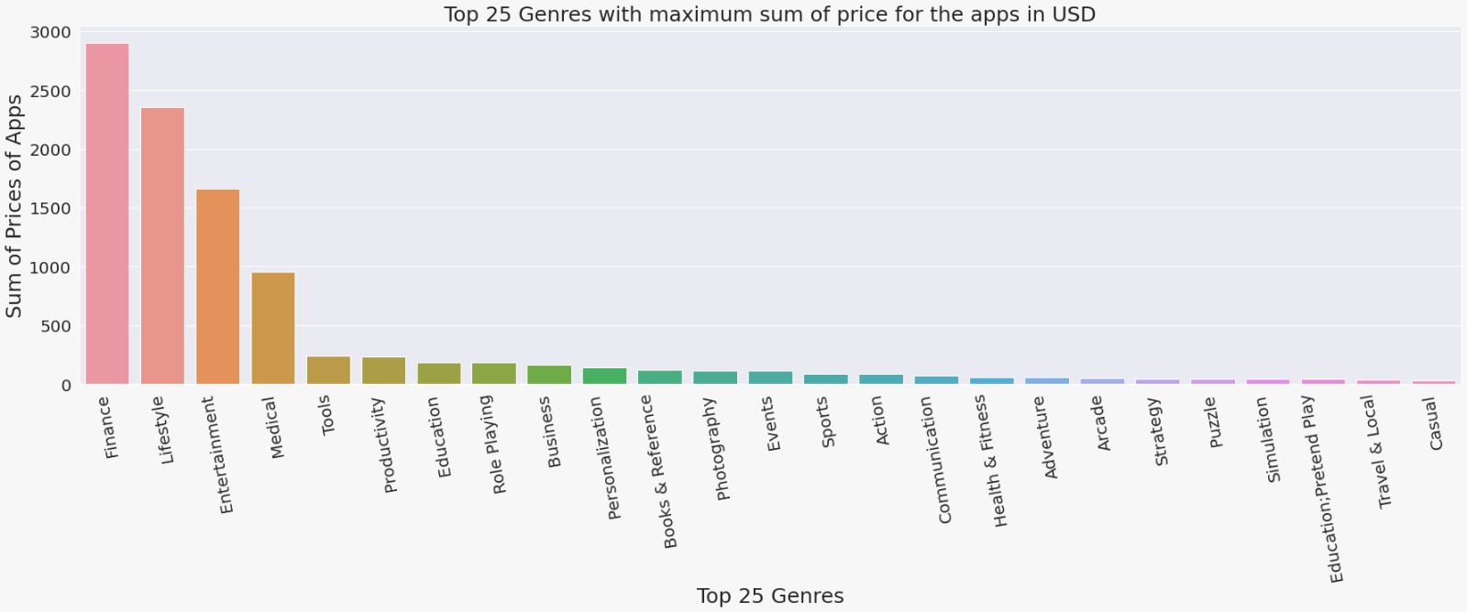
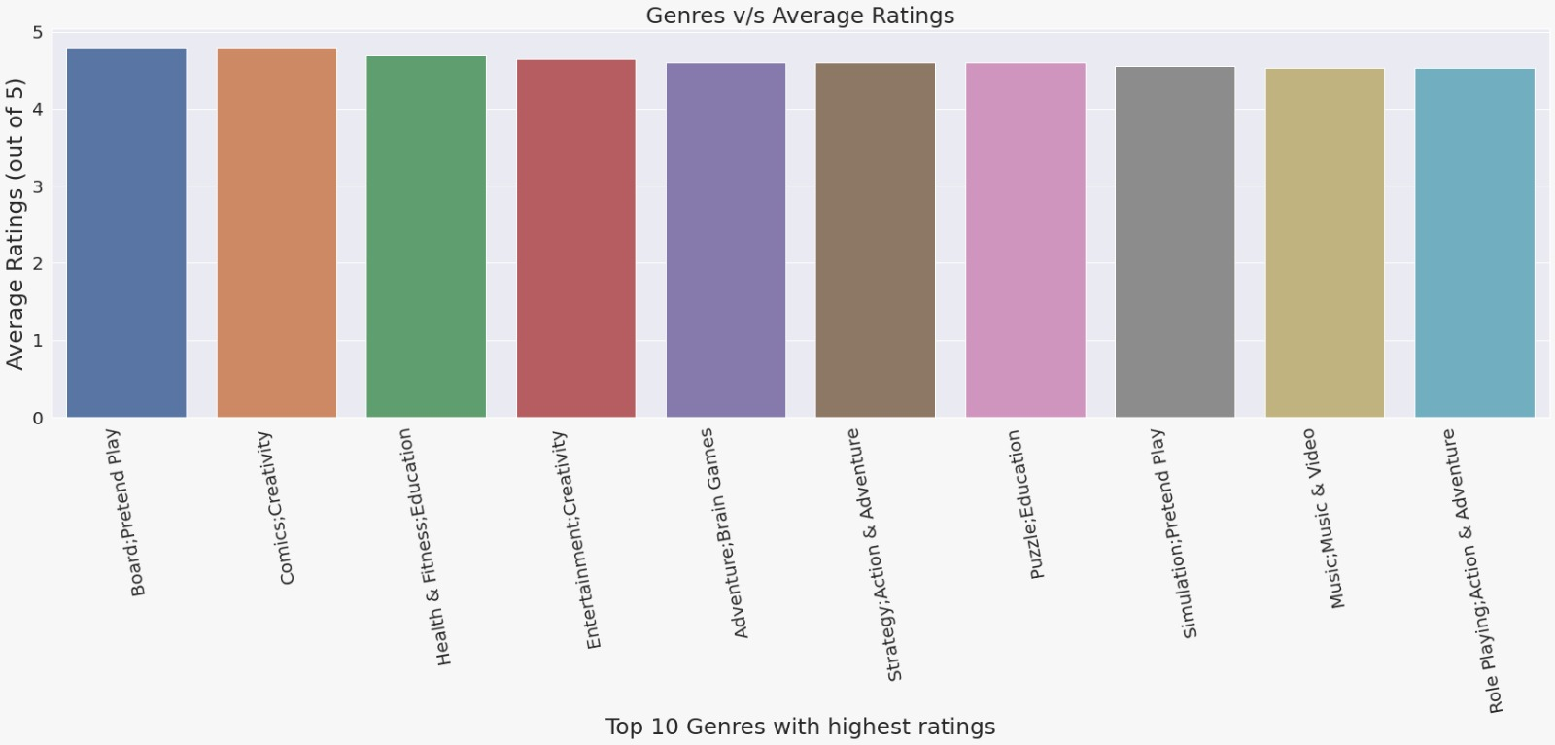
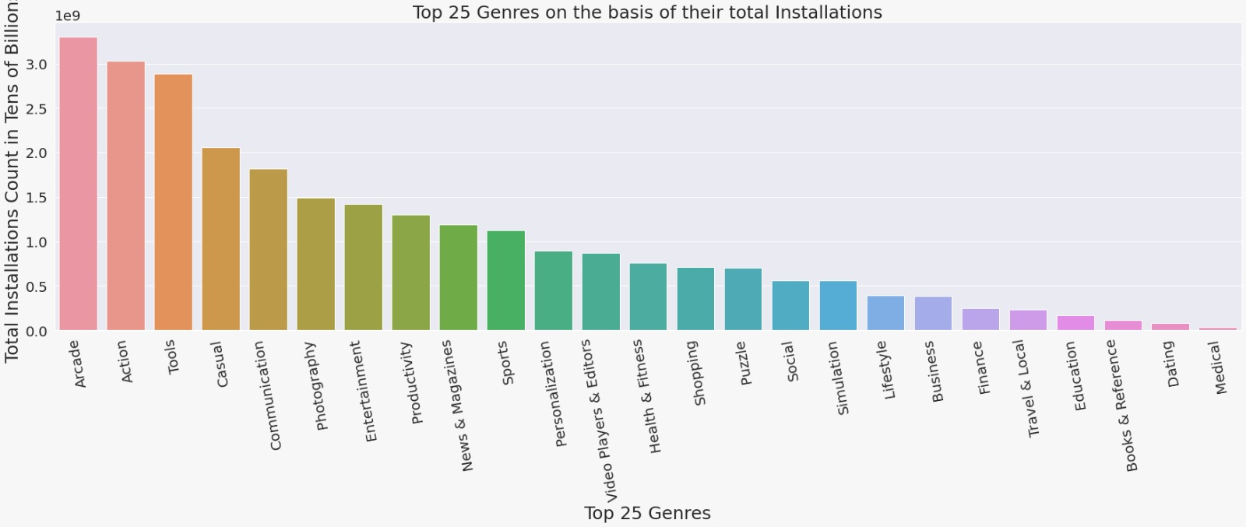
Genre to be exploited by the developer?
Genres

Slide 17
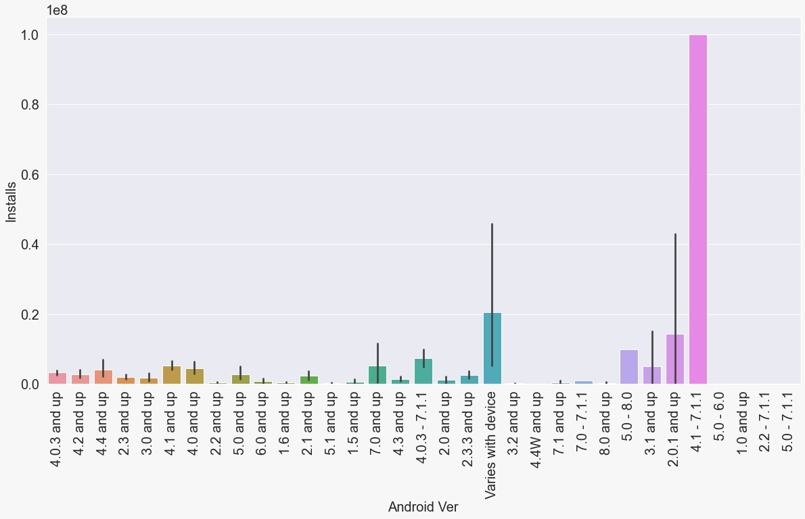
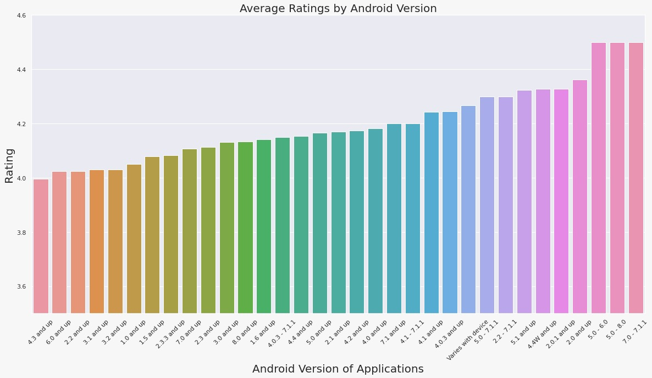
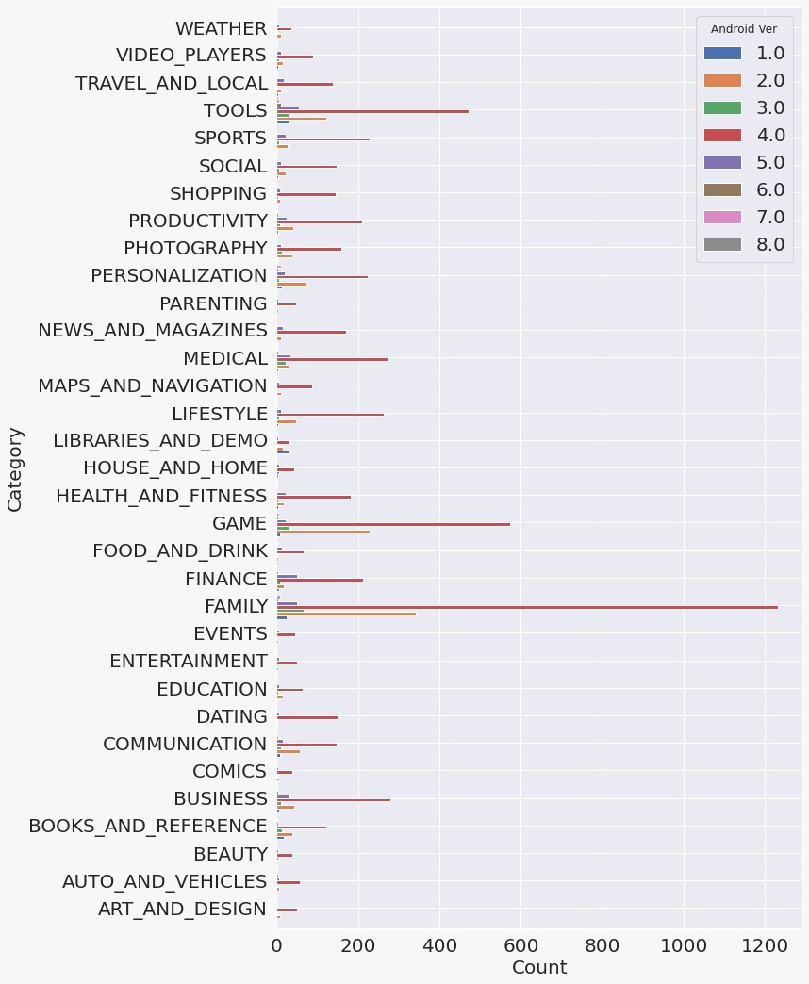
Range of backward compatibility?
Android Version

Slide 18
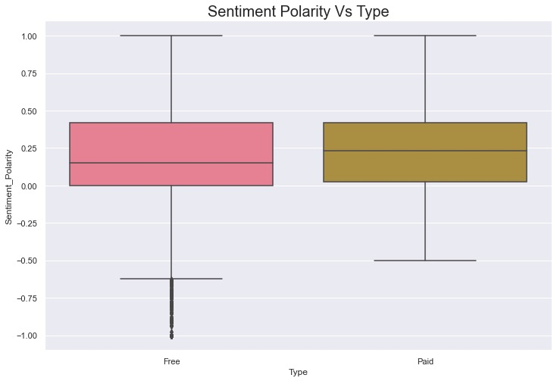
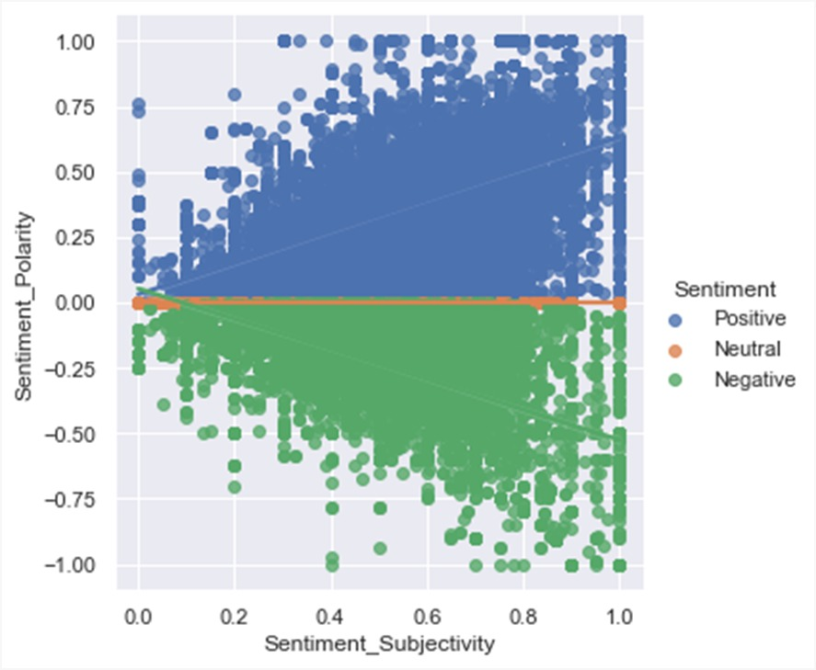
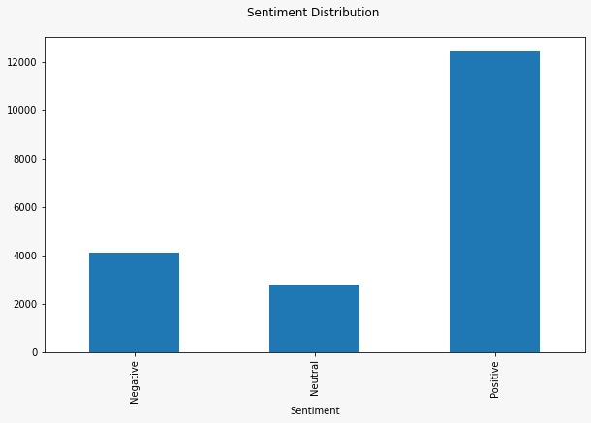
What does sentiment polarity reveal?
Sentiment

Slide 19
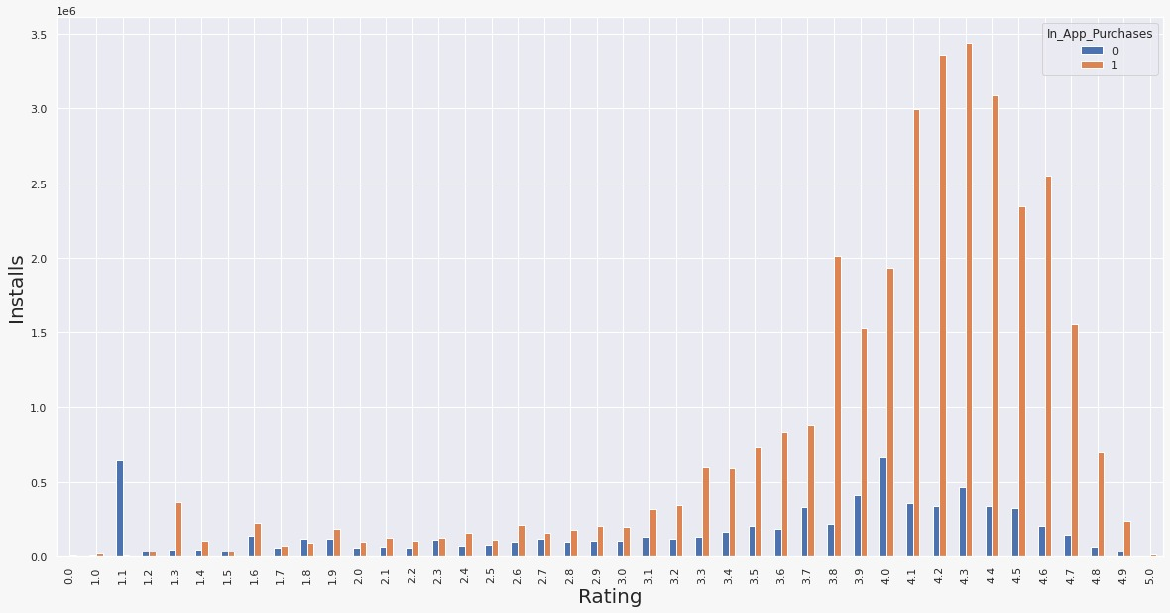
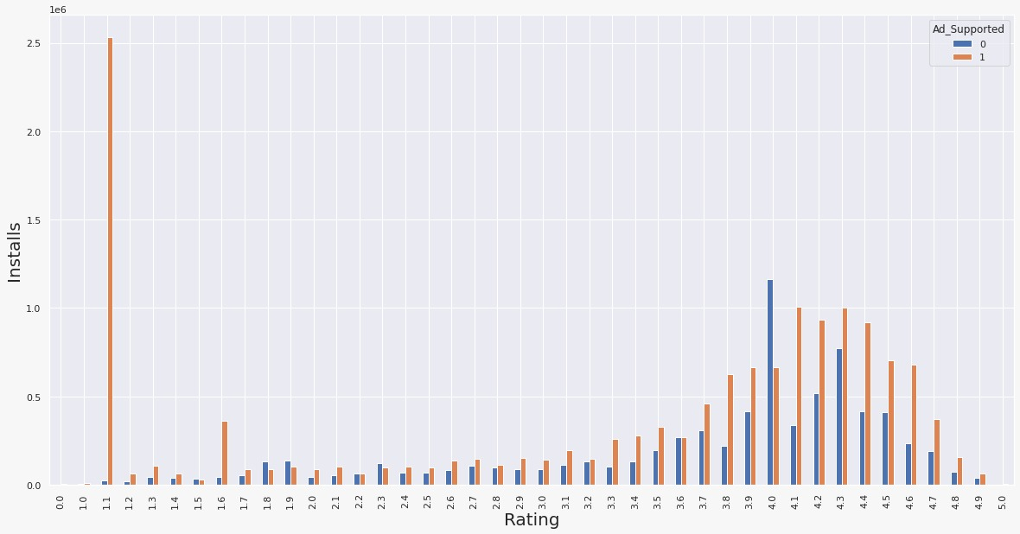
Do in-app ads or purchases have an impact on Installs?
In_app_adds & In_app_purchases

Slide 20
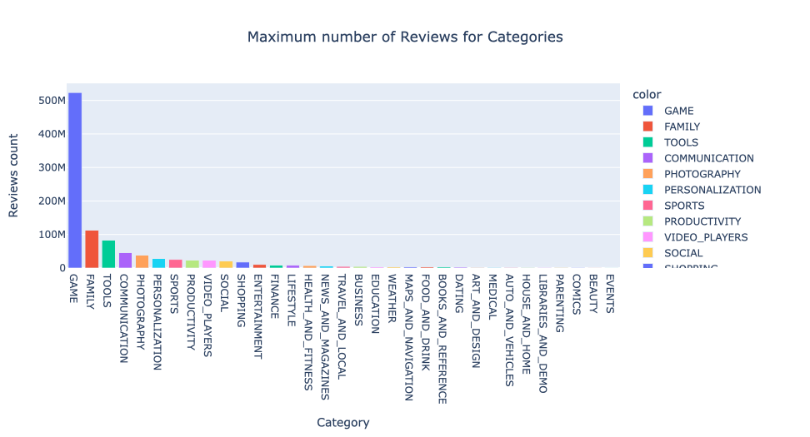
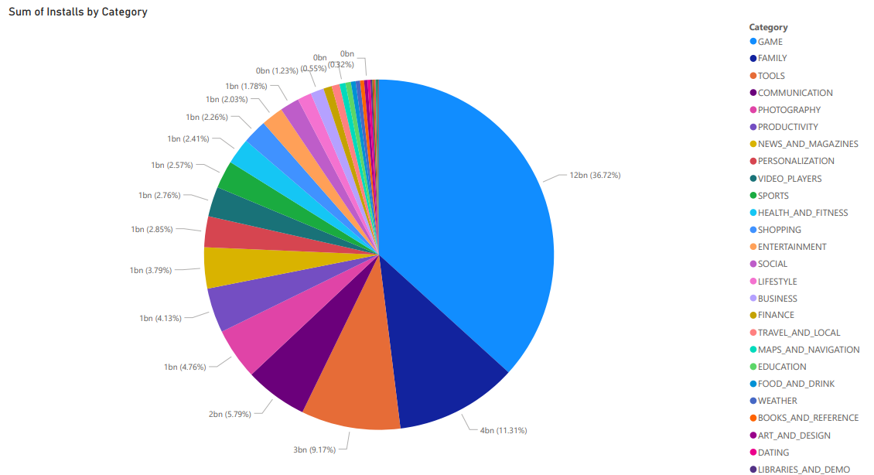
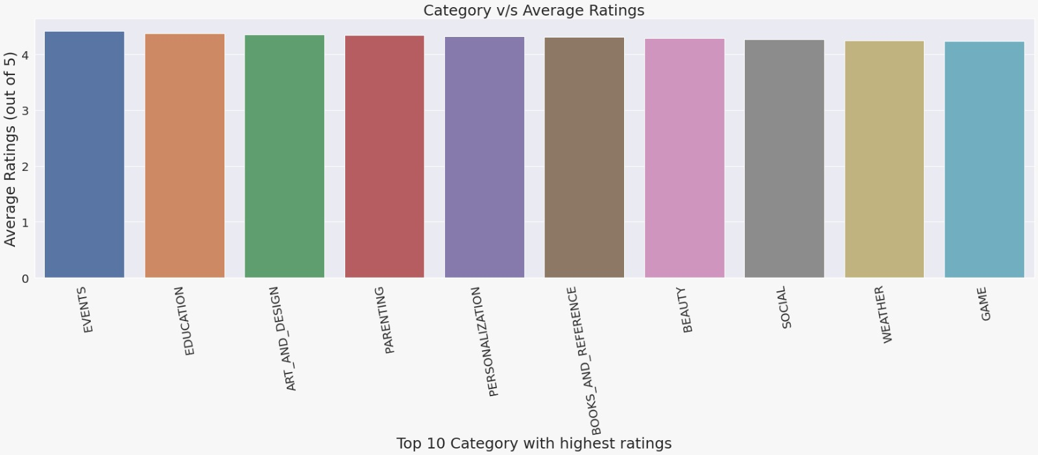
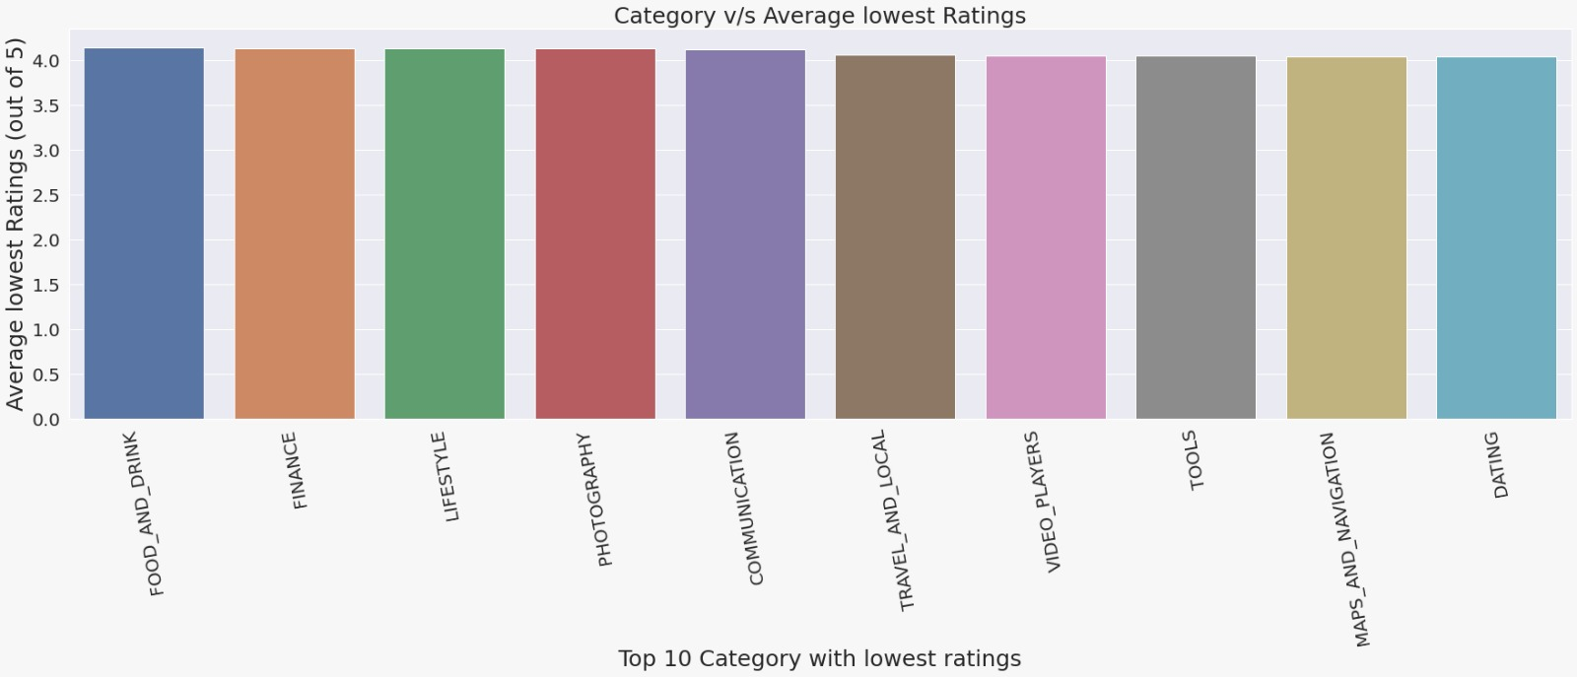
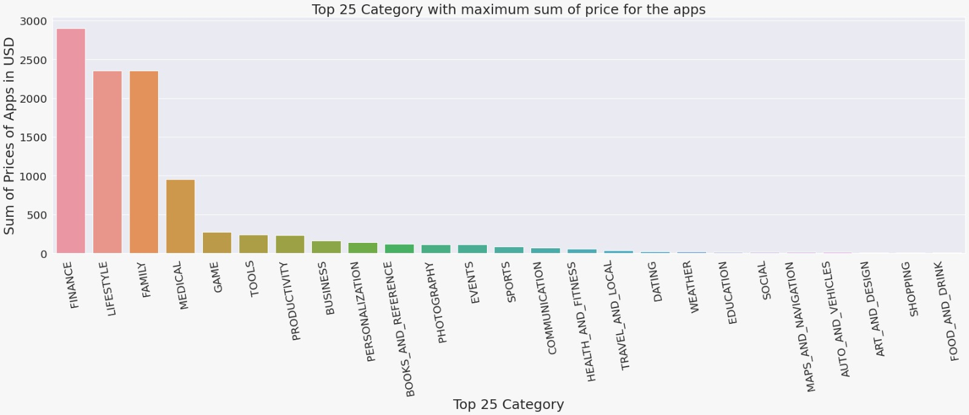
Category to be exploited by the developer?
Category

Slide 21
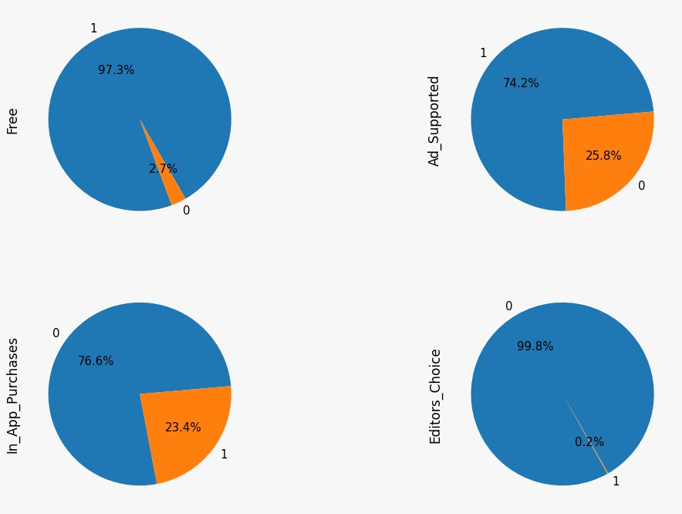
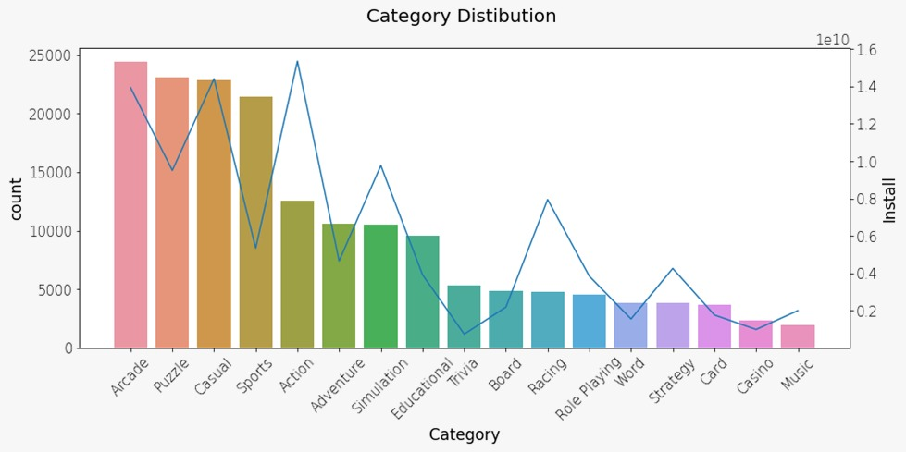
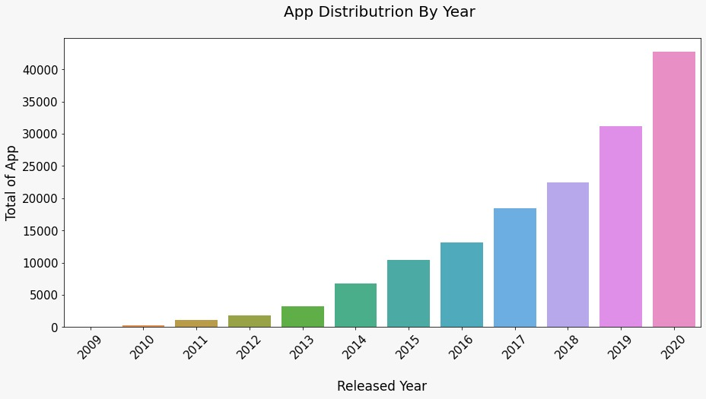
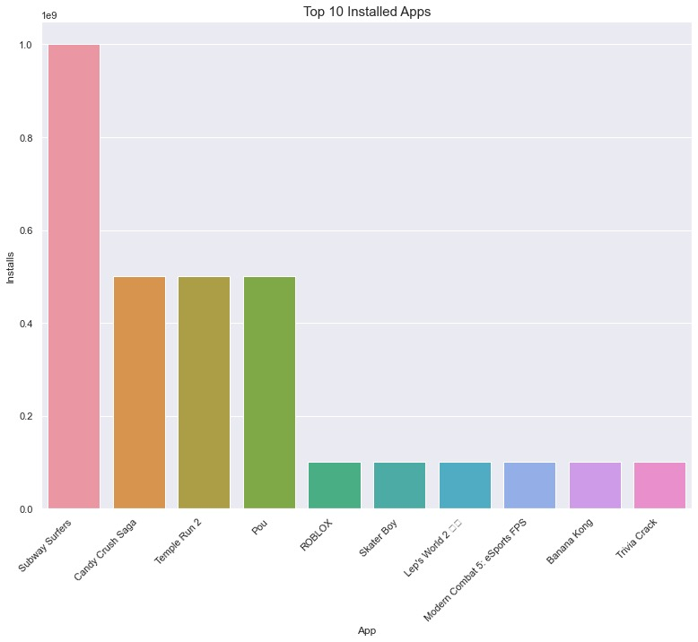
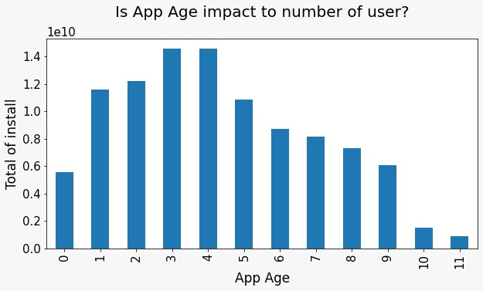
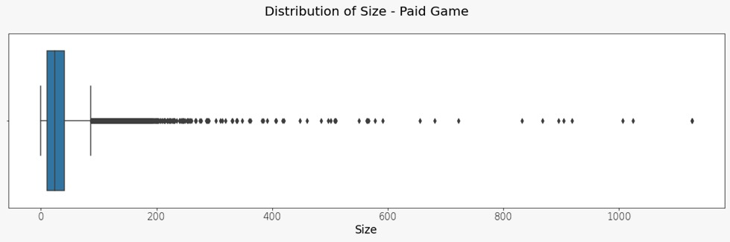
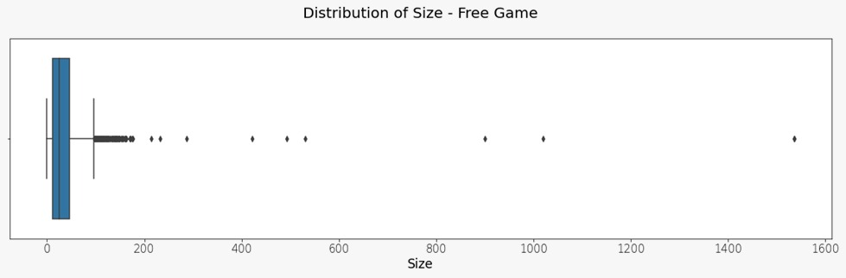
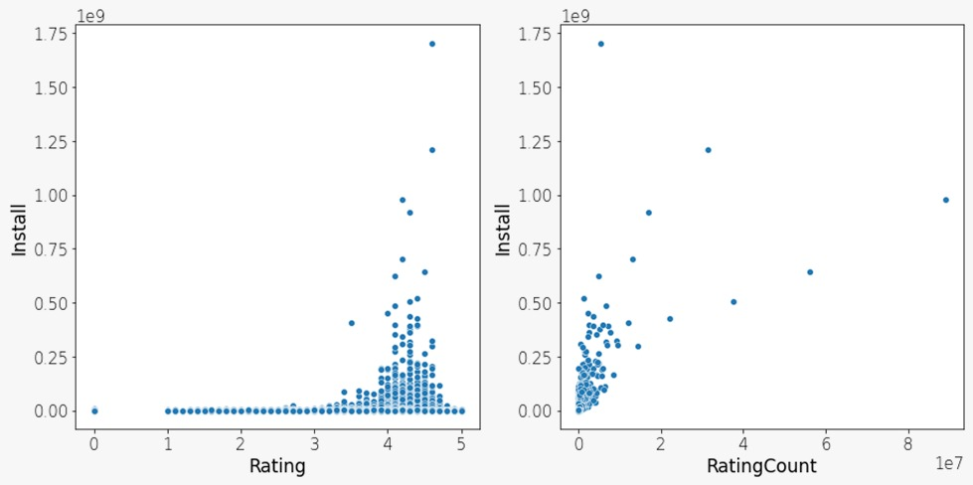
Deep dive analysis on the major category
Game Category

Slide 22
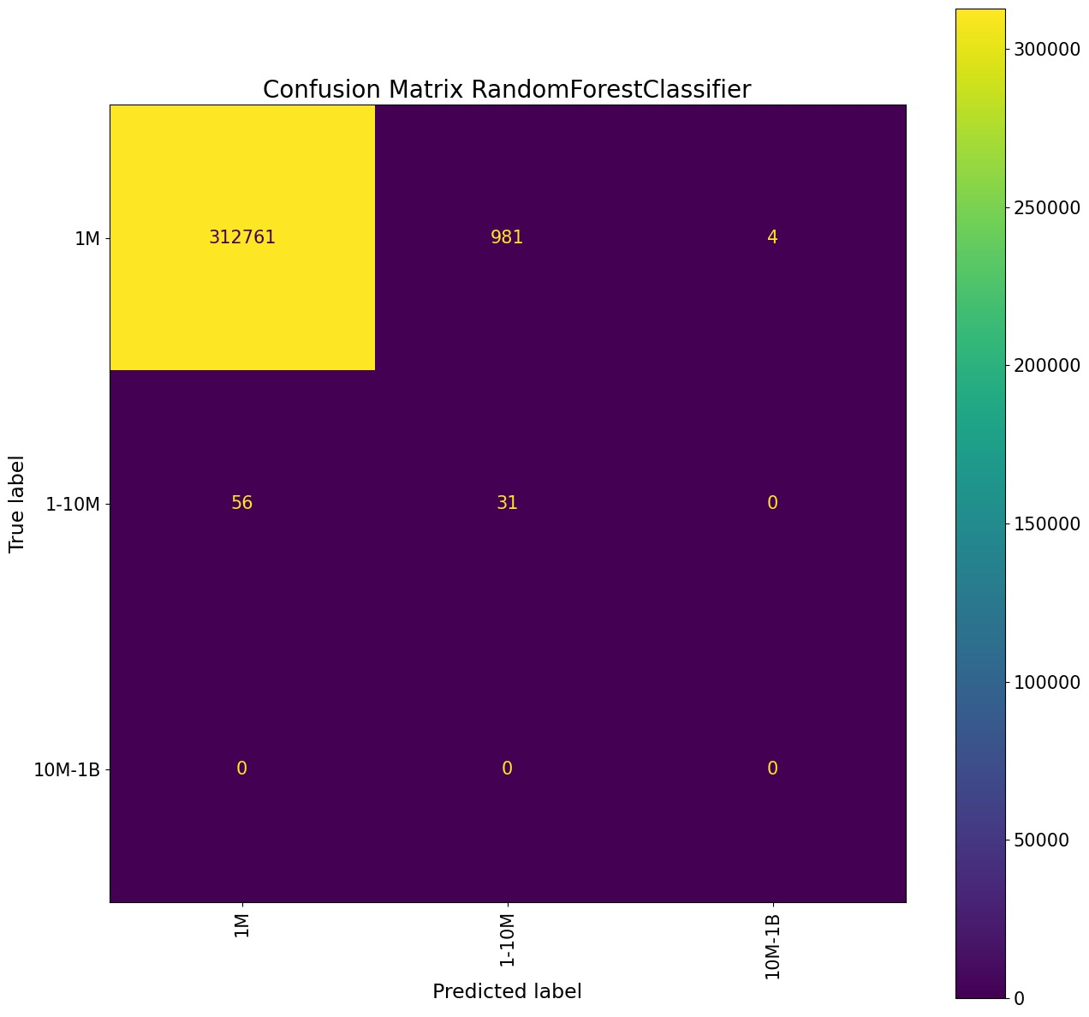

Models
Random Forest
Gradient Booster
Logistic Regression
Rating
Installs

Slide 23
Results & Discussions
App
Free
Paid
Size
Android Version
Content Rating
In-App ads
In-App Purchases
Price
(0 – $50)
Backward Compatibility
Subscription
One time Payment
Game
(100 Mb)
General Apps (35 to 70Mb)
Adult 18+ group
Everyone 10+

Slide 24
Conclusion
The information has the potential to provide insights that will help developers better understand client needs and, in turn, aid in the product's marketing
App Surveys
Sentiment Analysis
Future Works

Slide 25
Thank You

